Slide 1
Java Programming, 9e Chapter 13
File Input and Output

Slide 2
Objectives
Describe computer files
Use the Path and Files class
Describe file organization, streams, and buffers
Use Java’s IO classes to write to and read from a file
Create and use sequential data files
Appreciate random access files
Write records to a random access data file
Read records from a random access data file

Slide 3
Understanding Computer Files (1 of 4)
Volatile storage
Computer memory or random access memory (RAM)
Temporary
Nonvolatile storage
Not lost when computer loses power
Permanent
Computer file
Collection of information stored on nonvolatile device in computer system

Slide 4
Understanding Computer Files (2 of 4)
Permanent storage devices
Hard disks
Zip disks
USB drives
Reels or cassettes of magnetic tape
Compact discs
Categories of files by the way they store data
Text files
Binary files

Slide 5
Understanding Computer Files (3 of 4)
Data files
Contain facts and figures
Program files or application files
Store software instructions
Root directory
Folders or directories
Path
A complete list of disk drive plus the hierarchy of directories in which a file resides

Slide 6
Understanding Computer Files (4 of 4)
When you work with stored files in an application, you perform the following tasks:
Determine whether and where a path or file exists
Open a file
Write information to a file
Read data from a file
Close a file
Delete a file

Slide 7
Using the Path and Files Classes
Path class
Use it to create objects that contain information about files or directories
Files class
Use it to perform operations on files and directories
java.nio.file package
Include it to use both the Path and Files classes

Slide 8
Creating a Path
First, determine the default file system on the host computer
FileSystem fs = FileSystems.getDefault();
FileSystems contains factory methods for object creation
Define a Path using the getPath() method
Path path = fs.getPath ("C:\\Java\\Chapter.13\\Data.txt");
Every Path is either an absolute path or a relative path

Slide 9
Retrieving Information About a Path (1 of 3)
Table 13-1 Selected class methods
Method | Description
String toString() | Returns the String representation of the Path, eliminating double backslashes
Path getFileName() | Returns the file or directory denoted by this Path; this is the last item in the sequence of name elements
int getNameCount() | Returns the number of name elements in the Path
Path getName(int) | Returns the name in the position of the Path specified by the integer parameter

Slide 10
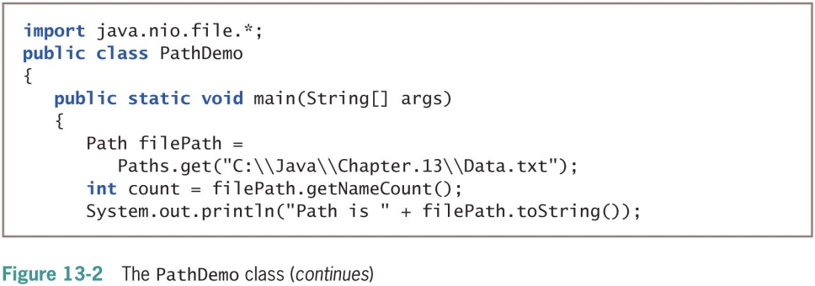
Retrieving Information About a Path (2 of 3)

Slide 11
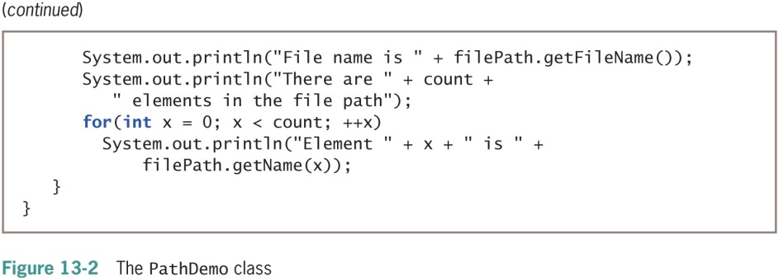
Retrieving Information About a Path (3 of 3)

Slide 12
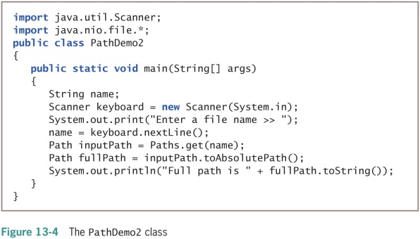
Converting a Relative Path to an Absolute One

Slide 13
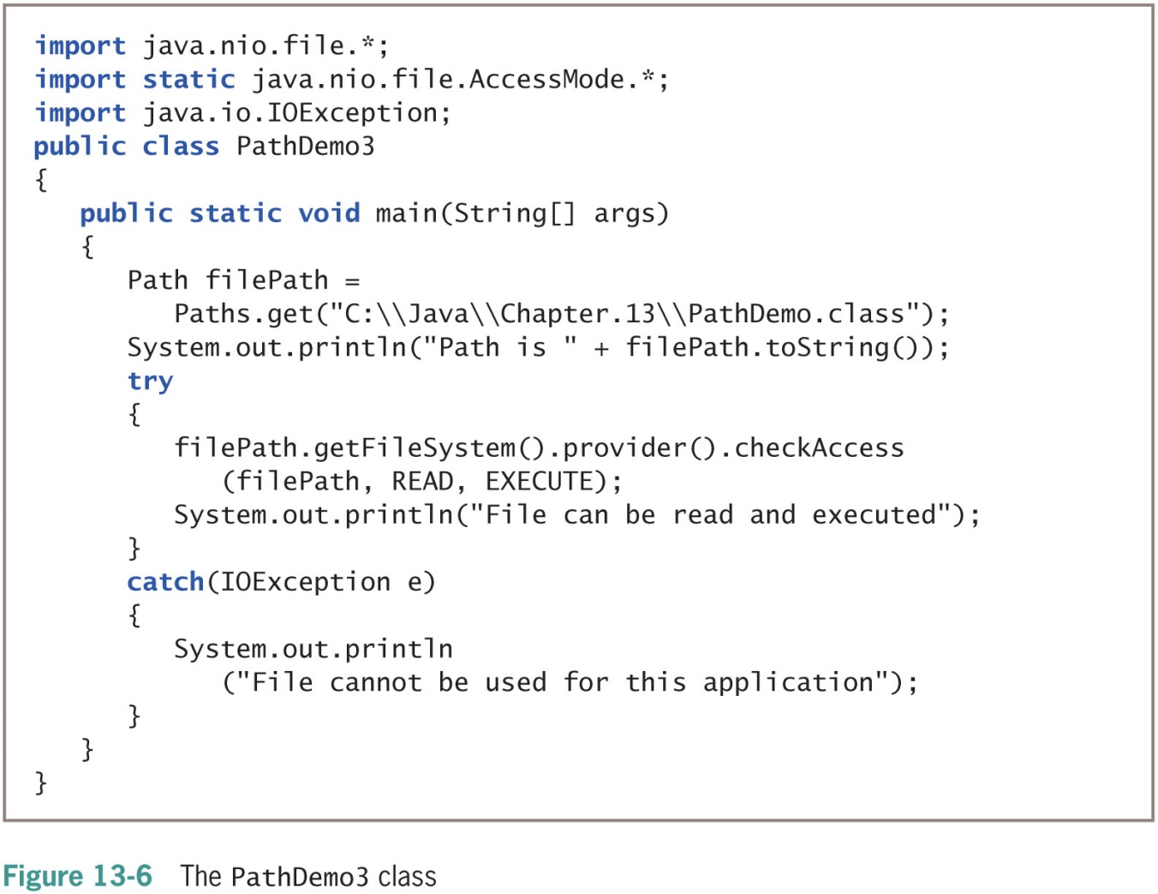
Checking File Accessibility

Slide 14
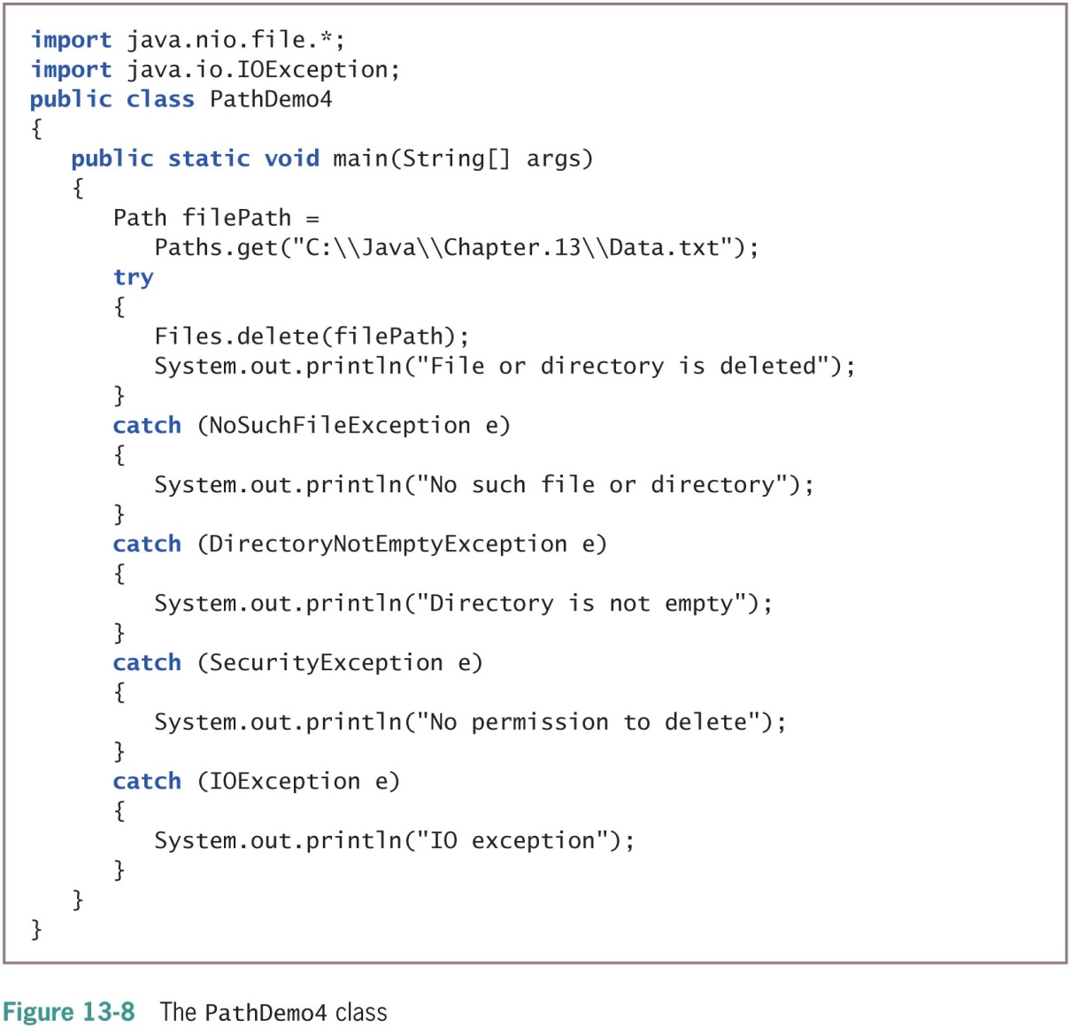
Deleting a Path

Slide 15
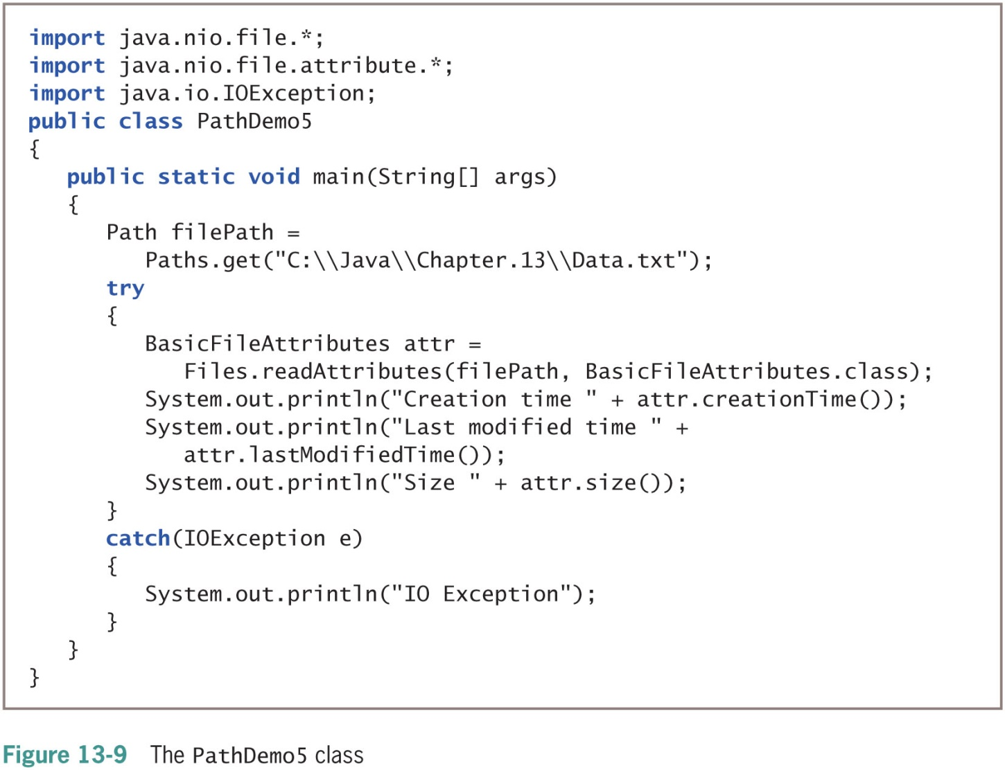
Determining File Attributes

Slide 16
File Organization, Streams, and Buffers (1 of 5)
When you need to retain data for any significant amount of time, save it on a permanent, secondary storage device
Businesses store data in hierarchy
Character
Field
Record
Files
Sequential access file
Each record is stored in order based on value in some field
Comma-separated values (CSV) file

Slide 17
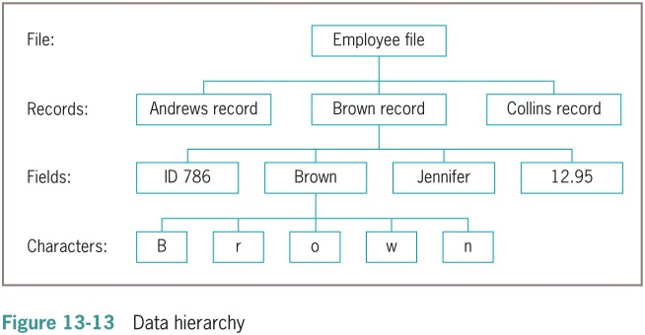
File Organization, Streams, and Buffers (2 of 5)

Slide 18
File Organization, Streams, and Buffers (3 of 5)
Open a file
Create object
Associate a stream of bytes with it
Close the file
Make it no longer available to your application
You should always close every file you open
Stream
Bytes flow into your program from an input device
Bytes flow out of your application to an output device
Most streams flow in only one direction

Slide 19
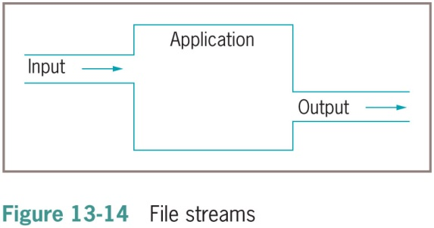
File Organization, Streams, and Buffers (4 of 5)

Slide 20
File Organization, Streams, and Buffers (5 of 5)
Buffer
Memory location where bytes are held after they are logically output, but before they are sent to the output device
Using a buffer improves program performance
Flushing
Clears any bytes that have been sent to a buffer for output, but have not yet been output to a hardware device

Slide 21
Using Java’s IO Classes (1 of 3)
InputStream, OutputStream, and Reader
Abstract classes that contain methods for performing input and output
System.out
PrintStream object
Defined in System class
System.err
Usually reserved for error messages

Slide 22
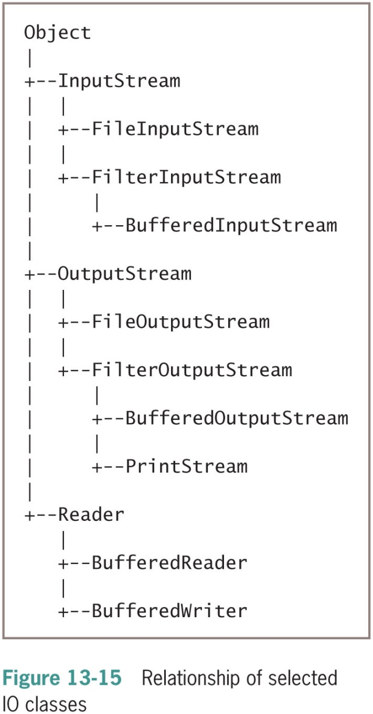
Using Java’s IO Classes (2 of 3)

Slide 23
Using Java’s IO Classes (3 of 3)
Table 13-2 Description of selected classes used for input and output
Class | Description
InputStream | Abstract class that contains methods for performing input
FileInputStream | Child of InputStream that provides the capability to read from disk files
BufferedInputStream | Child of FilterInputStream, which is a child of InputStream; BufferedInputStream handles input from a system’s standard (or default) input device, usually the keyboard
OutputStream | Abstract class that contains methods for performing output
FileOutputStream | Child of OutputStream that allows you to write to disk files
BufferedOutputStream | Child of FilterOutputStream, which is a child of OutputStream; BufferedOutputStream handles input from a system’s standard (or default) output device, usually the monitor
PrintStream | Child of FilterOutputStream, which is a child of OutputStream; System.out is a PrintStream object
Reader | Abstract class for reading character streams; the only methods that a subclass must implement are read (char[], int, int) and close()
BufferedReader | Reads text from a character-input stream, buffering characters to provide for efficient reading of characters, arrays, and lines
BufferedWriter | Writes text to a character-output stream, buffering characters to provide for the efficient writing of characters, arrays, and lines

Slide 24
Writing to a File (1 of 3)
Assign file to the OutputStream
Construct a BufferedOutputStream object
Assign it to the OutputStream
Create a writeable file by using the Path class newOutputStream() method
Creates a file if it does not already exist
Opens the file for writing and returns an OutputStream that can be used to write bytes to the file

Slide 25
Writing to a File (2 of 3)
Table 13-4 Selected StandardOpenOption constants
StandardOpenOption | Description
WRITE | Opens the file for writing
APPEND | Appends new data to the end of the file; use this option with WRITE or CREATE
TRUNCATE_EXISTING | Truncates the existing file to 0 bytes so the file contents are replaced; use this option with the WRITE option
CREATE_NEW | Creates a new file only if it does not exist; throws an exception if the file already exists
CREATE | Opens the file if it exists or creates a new file if it does not
DELETE_ON_CLOSE | Deletes the file when the stream is closed; used most often for temporary files that exist only for the duration of the program

Slide 26
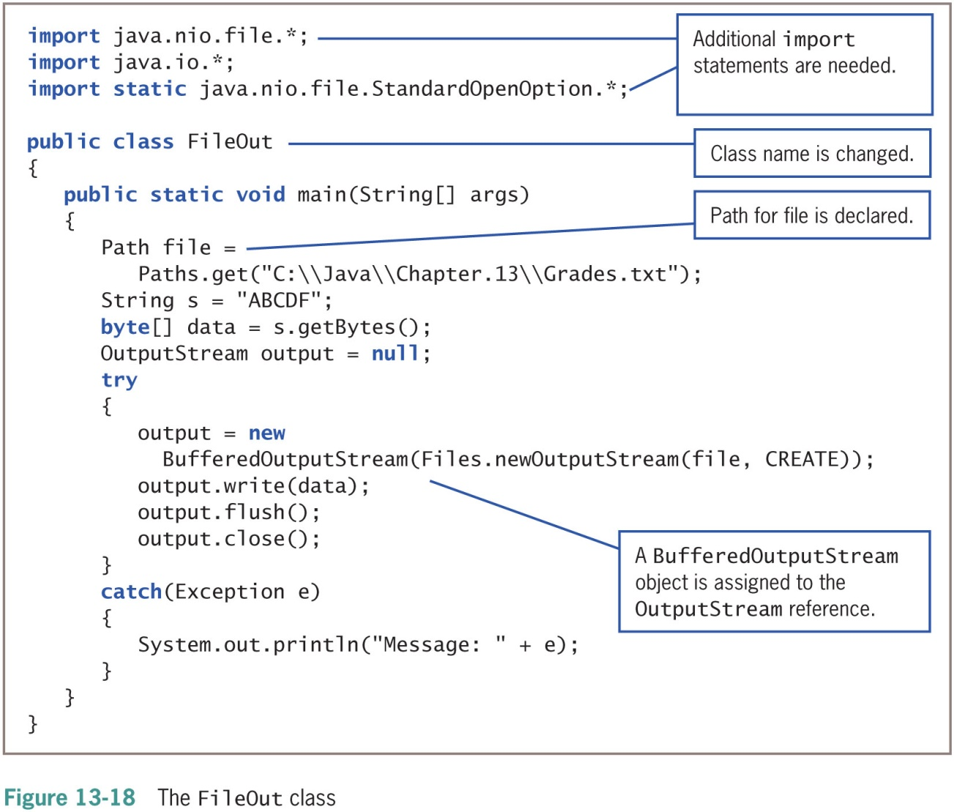
Writing to a File (3 of 3)

Slide 27
Reading from a File (1 of 3)
Use an InputStream as you would use an OutputStream
Open a file for reading with the newInputStream() method
Returns a stream that can read bytes from a file

Slide 28
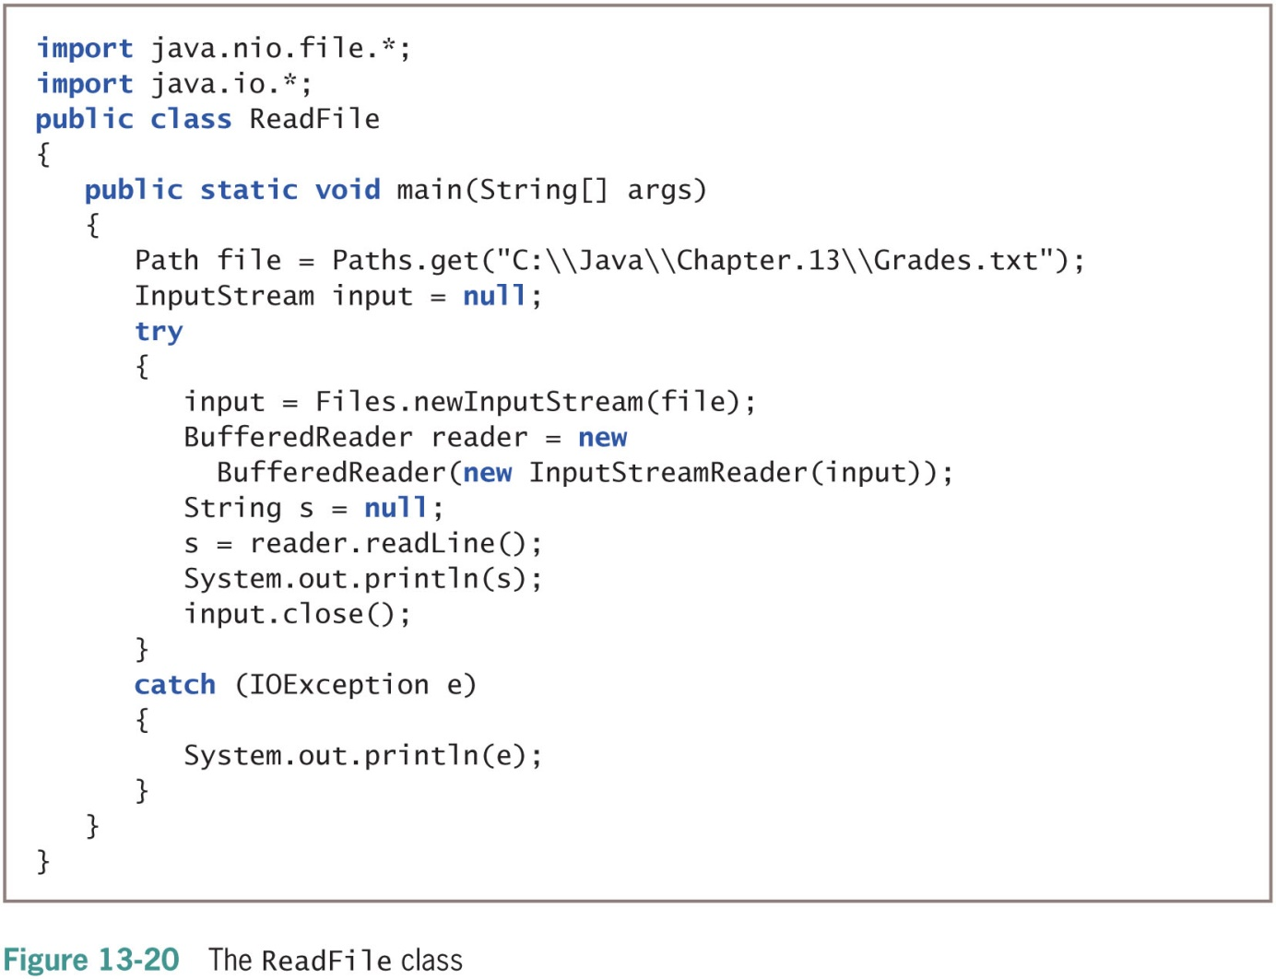
Reading from a File (2 of 3)

Slide 29
Reading from a File (3 of 3)
Table 13-5 Selected BufferedReader methods
BufferedReader Method | Description
close() | Closes the stream and any resources associated with it
read() | Reads a single character
read(char[] buffer, int off, int len) | Reads characters into a portion of an array from position off for len characters
readLine() | Reads a line of text
skip(long n) | Skips the specified number of characters

Slide 30
Creating and Using Sequential Data Files (1 of 5)
BufferedWriter class
Counterpart to BufferedReader
Writes text to an output stream, buffering the characters
The class has three overloaded write() methods that provide for efficient writing of characters, arrays, and strings, respectively

Slide 31
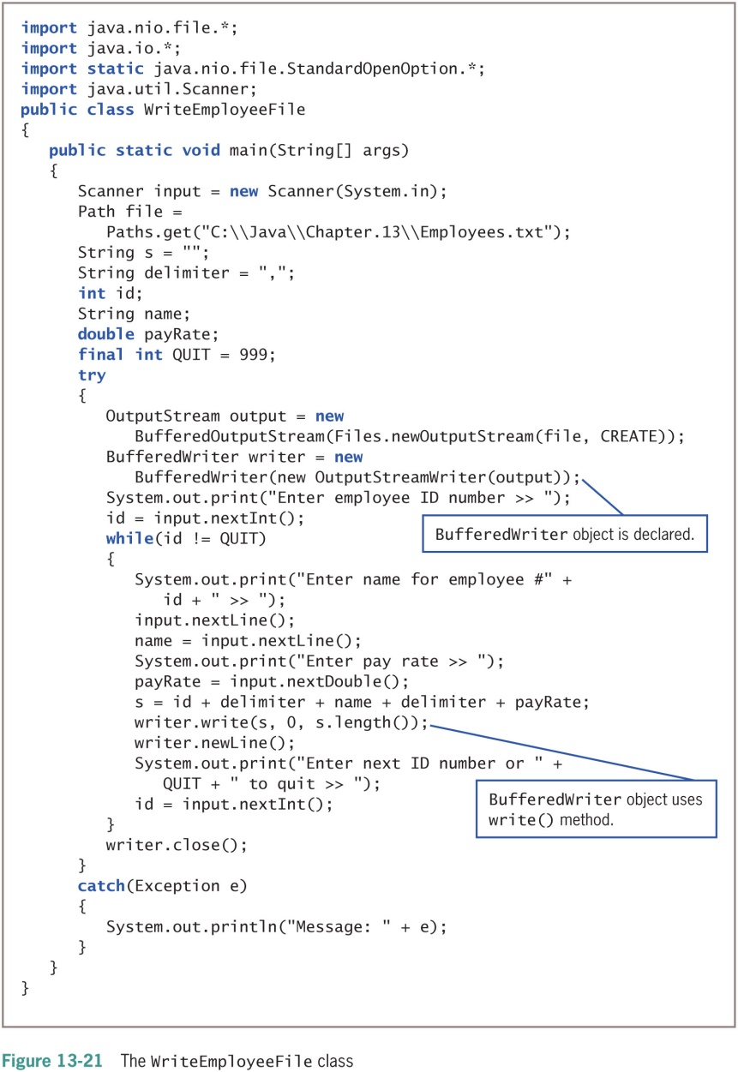
Creating and Using Sequential Data Files (2 of 5)

Slide 32
Creating and Using Sequential Data Files (3 of 5)
Table 13-6 BufferedWriter methods
BufferedWriter Method | Description
close() | Closes the stream, flushing it first
flush() | Flushes the stream
newline() | Writes a line separator
write(String s, int off, int len) | Writes a String from position off for length len
write(char[] array, int off, int len) | Writes a character array from position off for length len
write(int c) | Writes a single character

Slide 33
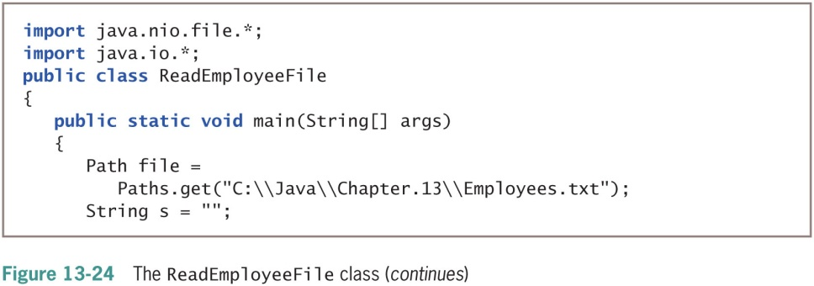
Creating and Using Sequential Data Files (4 of 5)

Slide 34
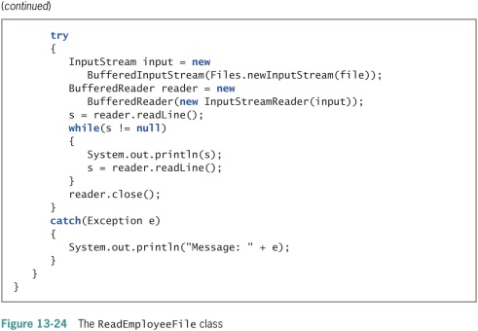
Creating and Using Sequential Data Files (5 of 5)

Slide 35
Learning About Random Access Files (1 of 5)
Sequential access files
Access records sequentially from beginning to end
Good for batch processing
Same tasks with many records one after the other
Inefficient for many applications
Real-time applications
Require immediate record access while client waits
Interactive program

Slide 36
Learning About Random Access Files (2 of 5)
Random access files
Records can be located in any order
Also called direct access files or instant access files
File channel object
An avenue for reading and writing a file
You can search for a specific file location (seekable), and operations can start at any specified position
ByteBuffer wrap() method
Encompasses (wraps) an array of bytes into a ByteBuffer

Slide 37
Learning About Random Access Files (3 of 5)
Table 13-7 Selected FileChannel methods
FileChannel Method | Description
FileChannel open(Path file, OpenOption... options) | Opens or creates a file, returning a file channel to access the file
long position() | Returns the channel’s file position
FileChannel position(long newPosition) | Sets the channel’s file position
int read(ByteBuffer buffer) | Reads a sequence of bytes from the channel into the buffer
long size() | Returns the size of the channel’s file
int write(ByteBuffer buffer) | Writes a sequence of bytes to the channel from the buffer

Slide 38
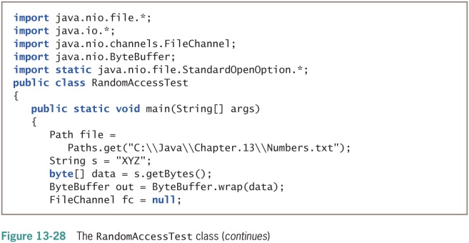
Learning About Random Access Files (4 of 5)

Slide 39
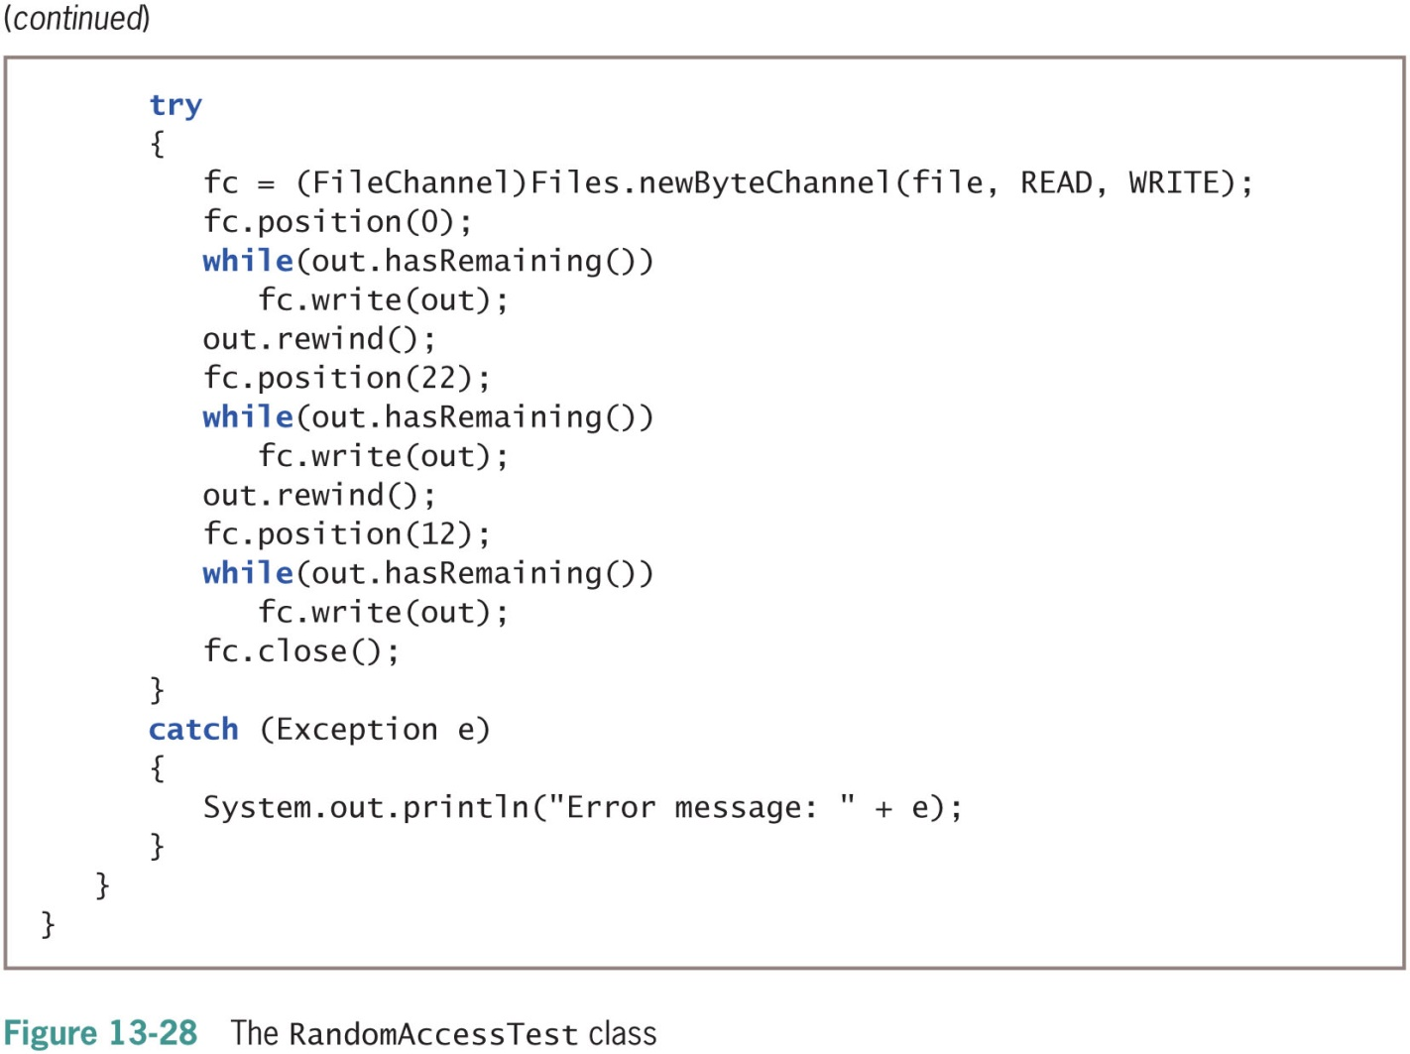
Learning About Random Access Files (5 of 5)

Slide 40
Writing Records to a Random Access Data File (1 of 3)
Access a particular record
fc.position((n-1) * 50);
Place records into the file based on a key field
Key field
A field that makes a record unique from all others

Slide 41
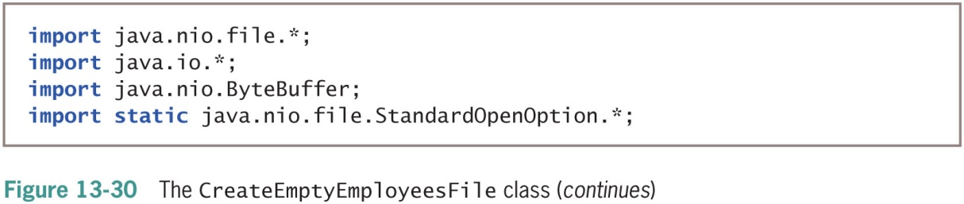
Writing Records to a Random Access Data File (2 of 3)

Slide 42
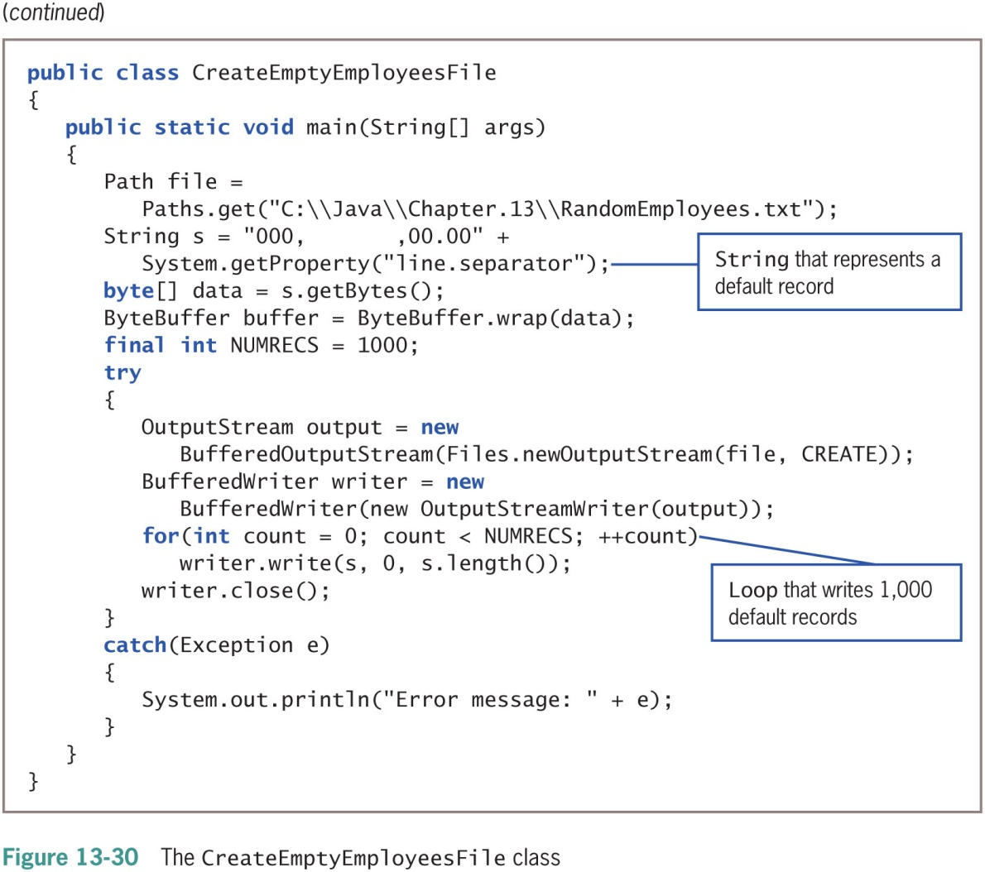
Writing Records to a Random Access Data File (3 of 3)

Slide 43
Reading Records from a Random Access File
You can process a random access file either sequentially or randomly

Slide 44
Accessing a Random Access File Sequentially
ReadEmployeesSequentially application
Reads through 1,000-record RandomEmployees.txt file sequentially in a for loop (shaded)
When ID number value is 0:
No user-entered records are stored at that point
The application does not bother to print it

Slide 45
Accessing a Random Access File Randomly (1 of 2)
To display records in order based on the key field, you do not need to create a random access file and waste unneeded storage
Instead, sort the records
By using a random access file, you retrieve specific record from the file directly without reading through other records

Slide 46
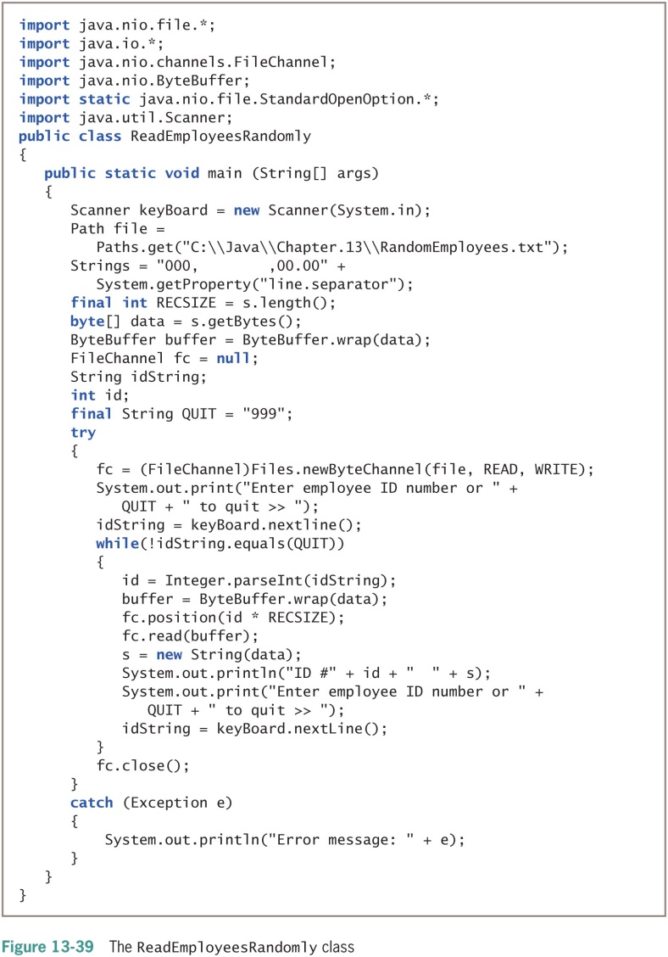
Accessing a Random Access File Randomly (2 of 2)

Slide 47
Don’t Do It
Don’t forget that a Path name might be relative and that you might need to make the Path absolute before accessing it
Don’t forget that the backslash character starts the escape sequence in Java
You must use two backslashes in a string that describes a Path in the DOS operating system

Slide 48
Summary (1 of 2)
Two types of storage
Temporary (volatile)
Permanent (nonvolatile)
Path class helps gather information about files
Files
Objects stored on nonvolatile, permanent storage
File and Files class
Gather file information
Java views file as a series of bytes
Views a stream as an object through which input and output data flows
DataOutputStream class
Accomplishes formatted output

Slide 49
Summary (2 of 2)
DataInputStream objects
Read binary data from InputStream
Random access files
Records can be located in any order
Use a key field to distinguish each record
RandomAccessFile class

